Slide 1
Consumer Purchase Behaviour Logistic Regression ML Model
By Ankit B. Raut
Mentorness Internship

Slide 2
Agenda
Objectives
Introduction
Dataset Dictionary
System Design
Methodology
Dataset Reading
Continuous Variable Visual Analysis
Categorical Variable Statistical Analysis
Technology Tested
Decision Tree ML Model Results
Conclusion

Slide 3
Introduction
A dataset containing customer information, including the following variables, develop a predictive model to estimate the likelihood of a customer making a purchase. The dataset contains information on Discounts Availed, Age, Time Spent on Websites , Number of Purchases, Annual Income, Loyalty Program.
Each row represents a uniqueness with various attributes that may influence Consumer Purchase Behaviour.

Slide 4
Objectives
The objective of this project is to develop a machine learning model that can predict whether a customer will make a purchase based on various demographic and behavioural features. The model will be trained on historical customer data and will aim to provide accurate predictions to support business decision-making processes. By analyzing these features, the model will predict future Consumer Behavioural trends, which can help in marketing strategies, improve customer retention, and increase sales.

Slide 5
Dataset Dictionary
• Age: Customer's age
• Gender: Customer's gender (0: Male, 1: Female)
• Annual Income: Annual income of the customer in dollars
• Number of Purchases: Total number of purchases made by the customer
• Product Category: Category of the purchased product (0: Electronics, 1: Clothing, 2: Home Goods, 3: Beauty, 4: Sports)
• Time Spent on Website: Time spent by the customer on the website in minutes
• Loyalty Program: Whether the customer is a member of the loyalty program (0: No, 1: Yes)
• Discounts Availed: Number of discounts availed by the customer (range: 0-5)
• Purchase Status: Likelihood of the customer making a purchase (0: No, 1: Yes)

Slide 6
System Design
A data flow diagram shows the way information flows through a process or system. It includes data inputs and outputs; data stores and the various sub processes the data moves through. DFDs are built using standardized symbols and notation to describe various entities and their relationships. In this project there is one DFD
Consumer Behaviour Prediction
User

Slide 7







System Design
Different processes are carried out to obtain the actual information such as one hot encoding. Then feature extraction is performed to extract necessary features. User can give an input to the detection model and it will provide an output.
Train Set
Evaluation
Model
Data
Data
Processing
Output
Test Set
Machine Algorithm
Inputs

Slide 8
Methodology
Literature Review
Dataset Collection
Data Pre-Processing
Feature Extraction
Training Set
Testing Set
Decision Tree
Error Calculation
Prediction

Slide 9
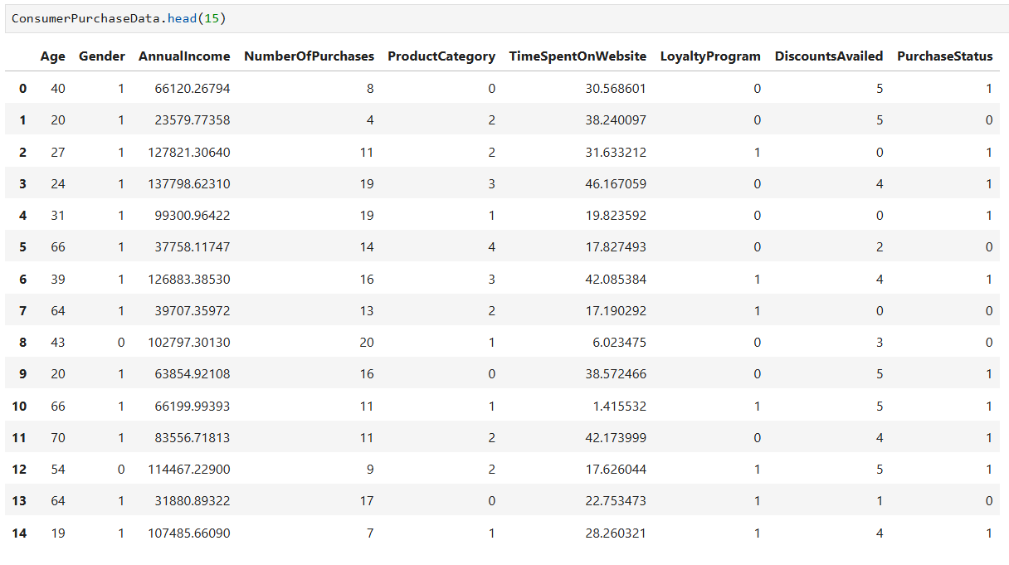
Dataset Reading

Slide 10
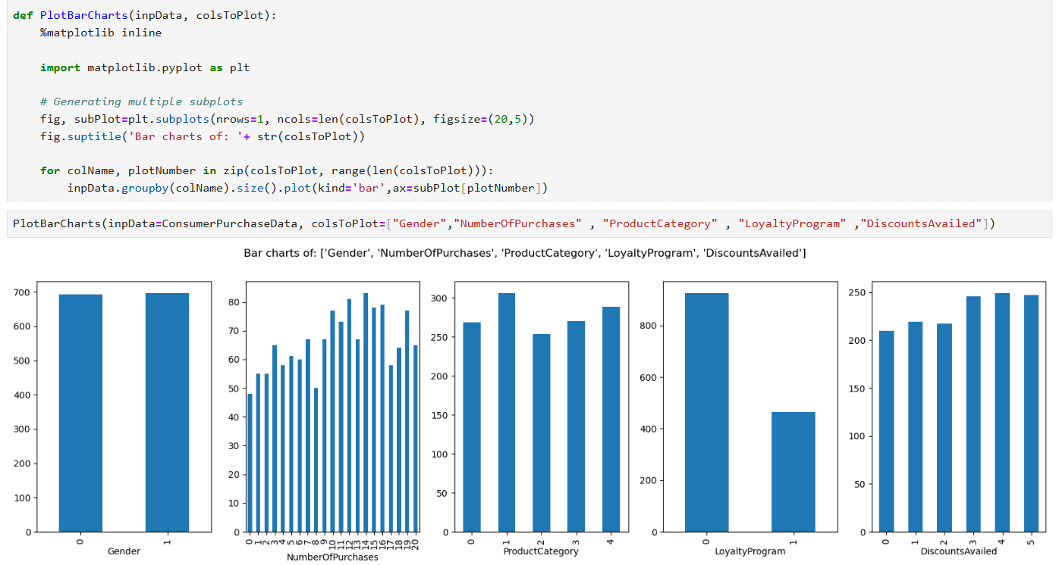
Exploratory Data Analysis for Categorical Variable

Slide 11
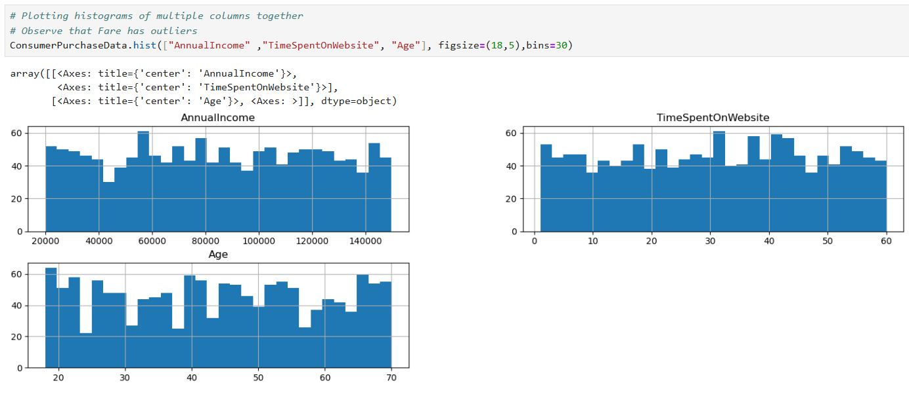
Exploratory Data Analysis for Continuous Variable

Slide 12
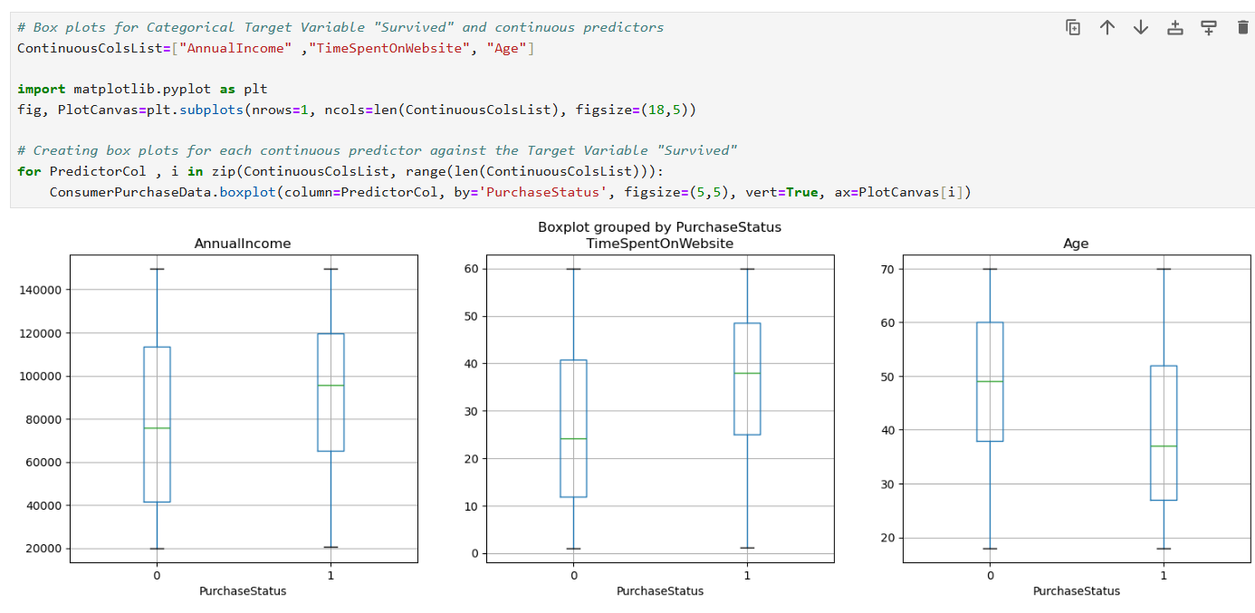
Categorical Vs Continuous Box Plots Analysis

Slide 13
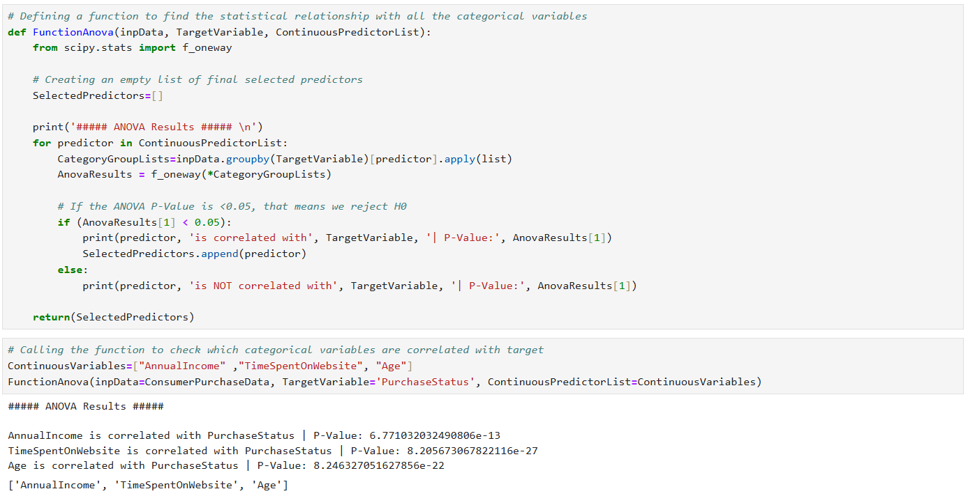
Statistical Feature Selection (Categorical Vs Continuous) Using ANOVA Test

Slide 14
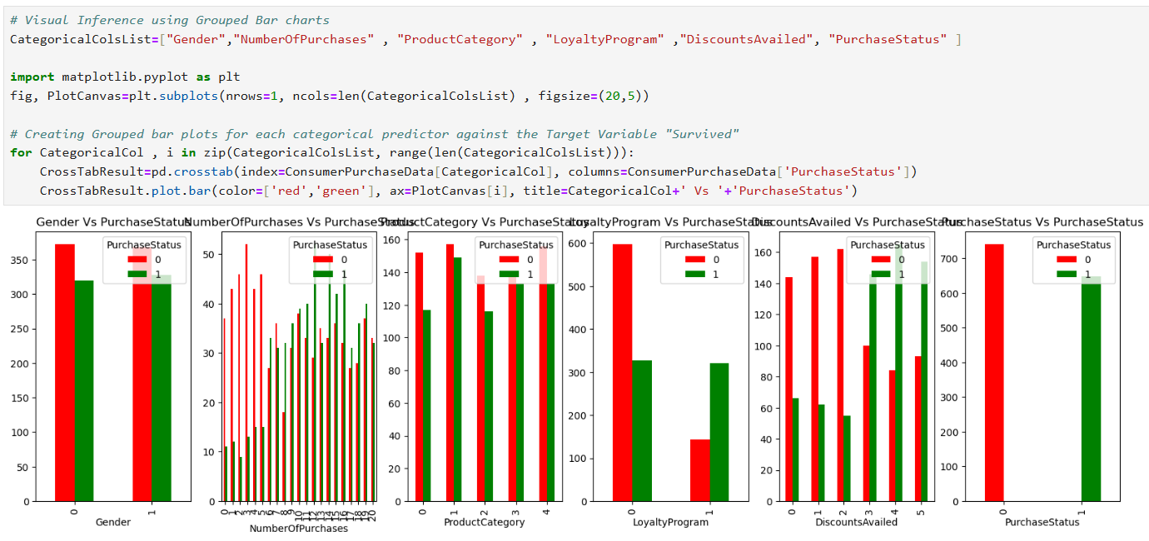
Categorical Vs Categorical -- Grouped Bar Charts

Slide 15
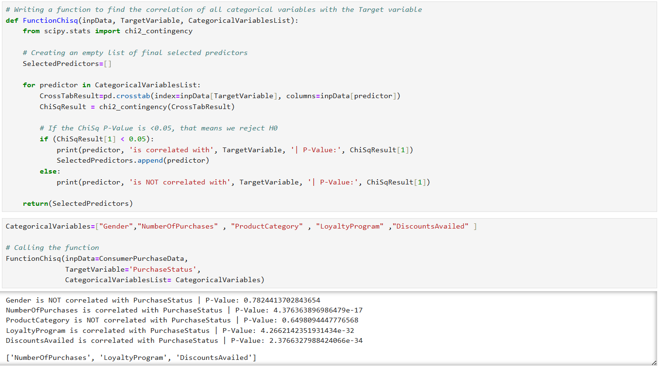
Statistical Feature Selection (Categorical Vs Categorical) Using Chi-square Test

Slide 16
Technology Tested
Decision Tree Machine Learning Algorithm: A decision tree prediction model is a type of supervised learning algorithm used for both classification and regression tasks. It models decisions and their possible consequences in a tree-like graph structure.
Linear Regression Machine Learning Algorithm: Regression is a method for predicting a dependent component with the help of independent variables. The method is commonly used to predict and calculate correlations between independent and dependent variables. The regression model establishes a linear or exponential connection between independent and dependent variables.

Slide 17
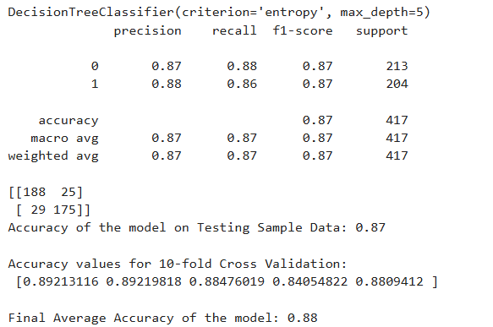
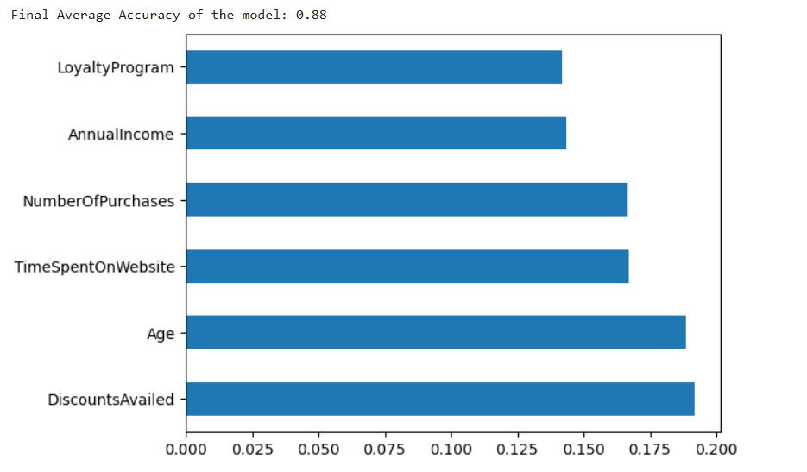
Decision Tree ML Model Results

Slide 18
Conclusion
In this project, A Decision Tree Model was successfully implemented employing various prominent algorithms from the Python libraries and modules.
Final Average Accuracy of the Model is 88%. DiscountsAvailed, Age, TimesSpentOnWebsite, NumberOfPurchases, AnnualIncome and LoyaltyProgram are more contributing features for getting higher accuracy to Machine Learning Model. So, we are getting more precise and accurate Machine Algorithm Model.

Slide 19
Thank You

